Slide 1

Capstone Project Car accident severity
Bart Fischer 09-10-2020

Slide 2
Introduction
Worldwide goal is a reductions of traffic accidents.
In 2013 => 1.25 million traffic accident deaths.
There’s a need to predict accidents and accident severity for
Safer routes
Optimize public transport
Improvement on infrastructure costs
Relevant for drivers, public transport officials and first responders
-

Slide 3
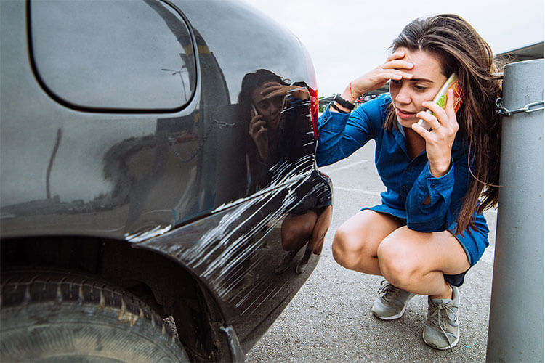
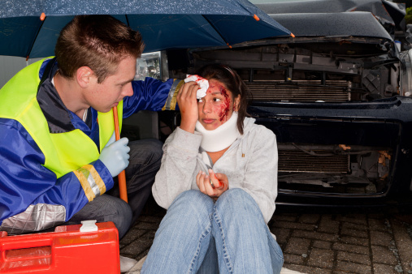
Goal
Investigate a road accident dataset with a binary severity class
Try to predict the severity of an accident,
Severity being property damage or injury.

Slide 4
Data provided
Accident from Jan-2004 to May-2020 in the Seattle (USA) area.
Total of 194673 collisions
Total of 38 attributes
Binary severity classification
Determine: Relevant and Non-relevant attributes

Slide 5
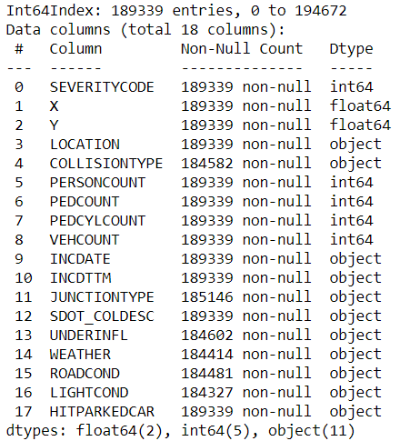
Data cleaned
All non-relevant attributes dropped
Final data set
189339 collisions
132221 Sev.Class 1 & 57118 Sev.Class 2.
Attributes remaining
1 Binary severity classification
Locations attributes
Time related attributes
Accident specific attributes
Additional attributes created
[‘Ratio’] = # Sev.Code 1/ # Sev.Code 2

Slide 6
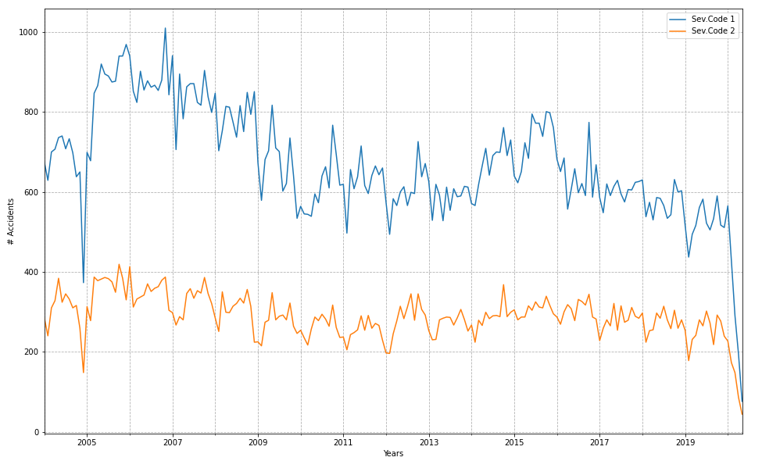
Methodology
Both types of severity over time. Note the yearly dip in winter compared to summer high of the years

Slide 7
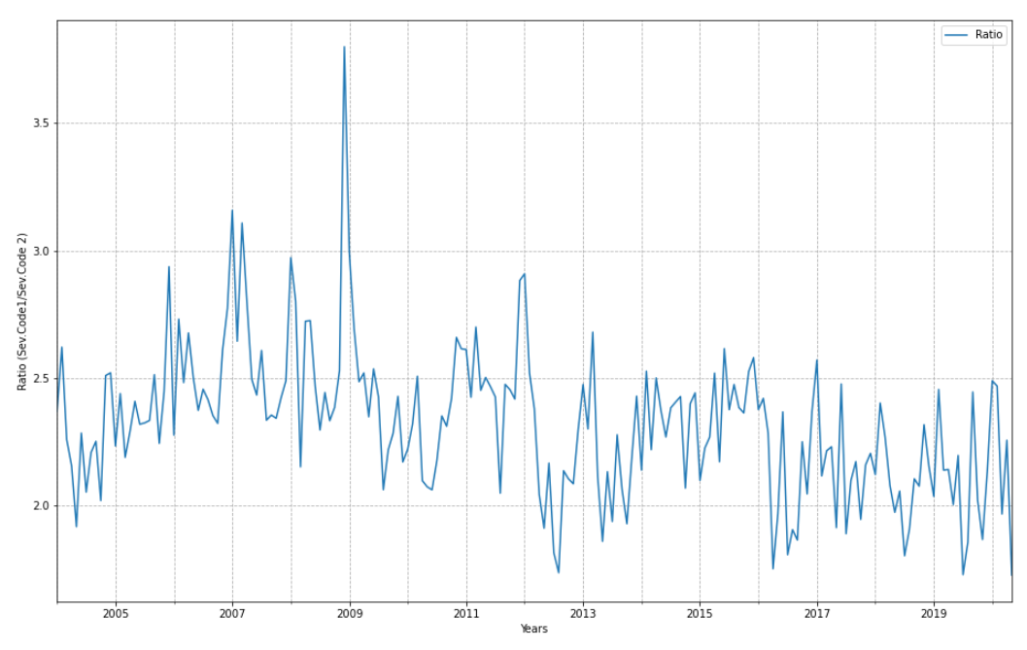
Methodology
Collision ratio of Sev. Code 1 / Sev. Code 2 over time.

Slide 8
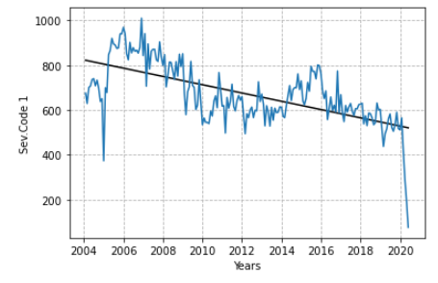
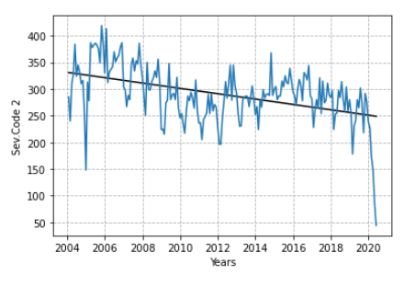
Analysis
Linear Regression of collision cases of Sev. Code 1 (left) and Sev. Code 2 (right) over time.

Slide 9
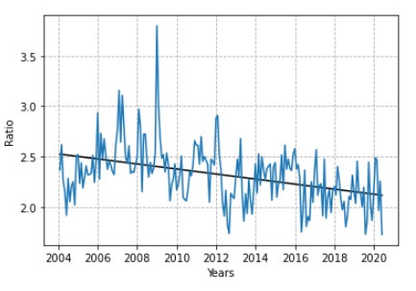
Analysis
Linear Regression of collision cases ratio of Sev. Code 1 / Sev. Code 2 over time.

Slide 10
Discussion
There is a decrease of total amount of cases over time
Injuries didn’t decrease as much collisions, as the ratio shows.
A pattern of summer/winter highs and lows needs to further investigated.
The OBJECT parameters can be further explored with grouping.
Example with “Weather” & “Road Conditions”

Slide 11
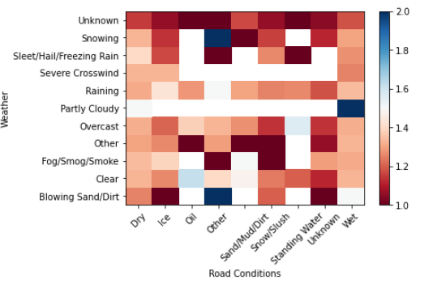
Discussion
Heat map of the grouping with 2 OBJECT attributes as example for further exploration.
‘Partly Clouded’ & ‘Wet’ has a blue value of 2, indication that with these conditions only severity code 2 accidents occur. Whilst ‘Partly Clouded’ and all other Road Condition parameters show a white value of 1.5 indicating a 1/1 ratio between code 1 and code 2 accidents.

Slide 12
Conclusion
Much more can be investigated, but wasn’t possible due to time limits.
The creation of additional parameters, eg [‘Ratio’], is useful,
From this parameter an indicator is the focus should shift more to injuries response than collateral damage response
The OBJECT parameters can be further explored with grouping.
The location parameters should be further explored with FOLIUM.

